Slide 1
Final Project On-board Testing Results
Neural Network Inference on FPGA
ECE 6213
Osama Yousuf, Joseph Riem

Slide 2
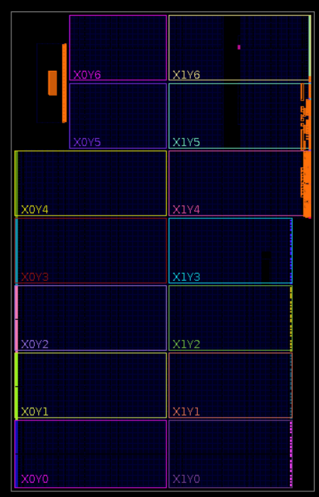
HLS Synthesized Design

Slide 3
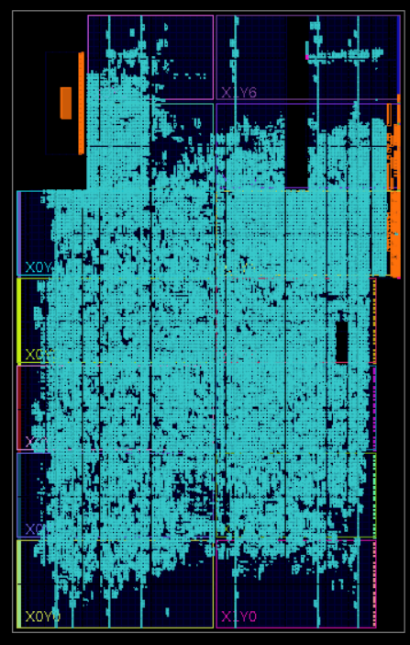
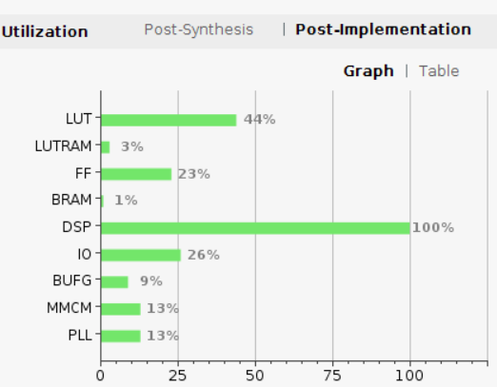
HLS Implemented Design
Utilization Report

Slide 4
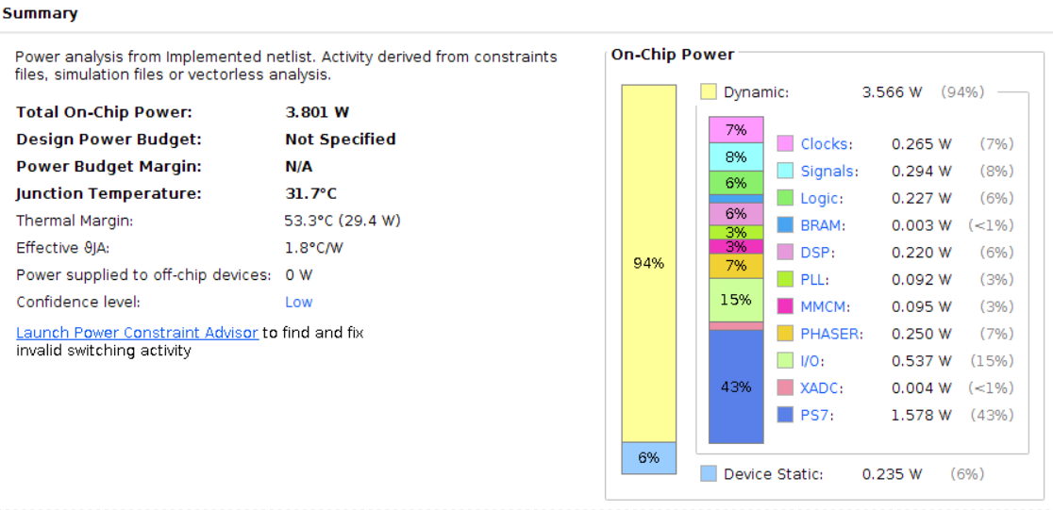
HLS Network – Power Report

Slide 5
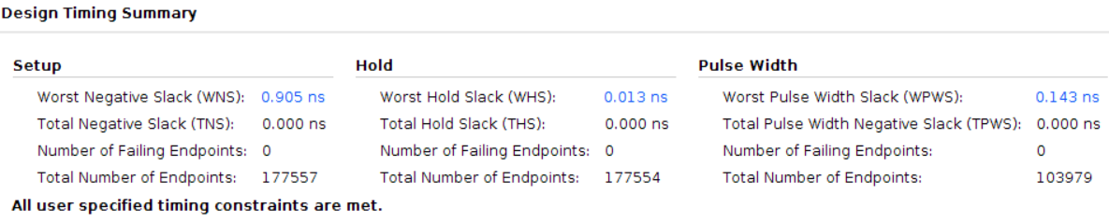
HLS Network – Timing Report

Slide 6
Thank You Questions/Comments?

